Slide 1
Metal prices & Inflation Analysis
Name: kiran harihar karale

Slide 2
Introduction
Metals: Aluminium, Gold, Silver, Nickel, Uranium
- Examining price trends
- Inflation impact
- Key patterns"
- Key patterns"

Slide 3
Inflation
Inflation is the general increase in prices of goods and services over time, which reduces the purchasing power of money.
How Inflation Is Measured
Inflation is typically measured using price indices, which track the cost of a representative basket of goods and services over time:

Slide 4
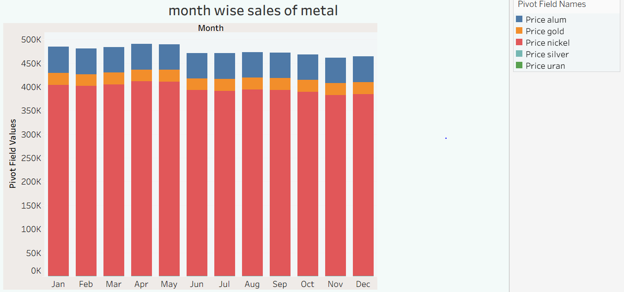
Month wise sales of metals so we see the sales of nickel is highest as compare to Other metals

Slide 5
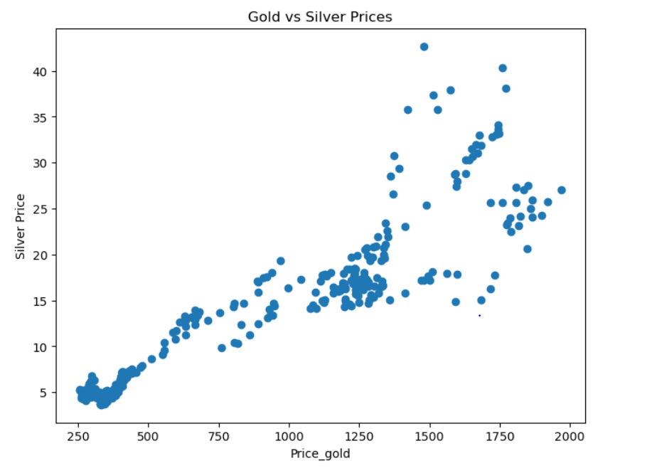
Linear regression
The scatter plot shows a positive correlation between Gold Price (x-axis) and Silver Price (y-axis).
1. Trend: As gold price increases, silver price tends to increase linearly.
2. Relationship: The two metals' prices move together, suggesting a strong market linkage.
3. Outliers: A few points deviate from the main trend (around gold price 1500–1750), indicating potential anomalies or market events.
4. Modeling: You could build a linear regression model to predict silver price using gold price.

Slide 6
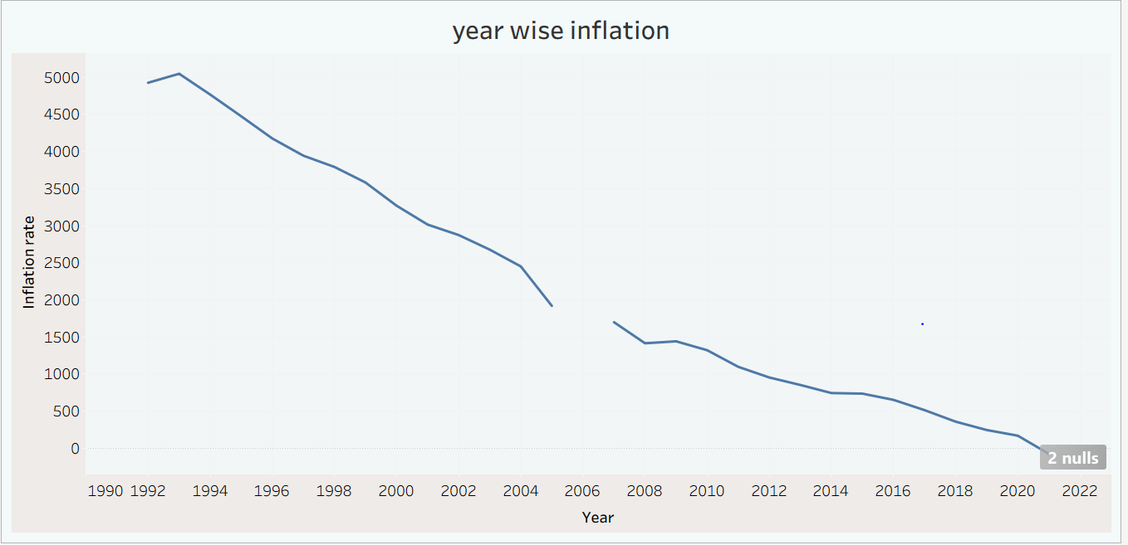
"Based on the graph, it can be inferred that inflation is continuously decreasing."

Slide 7
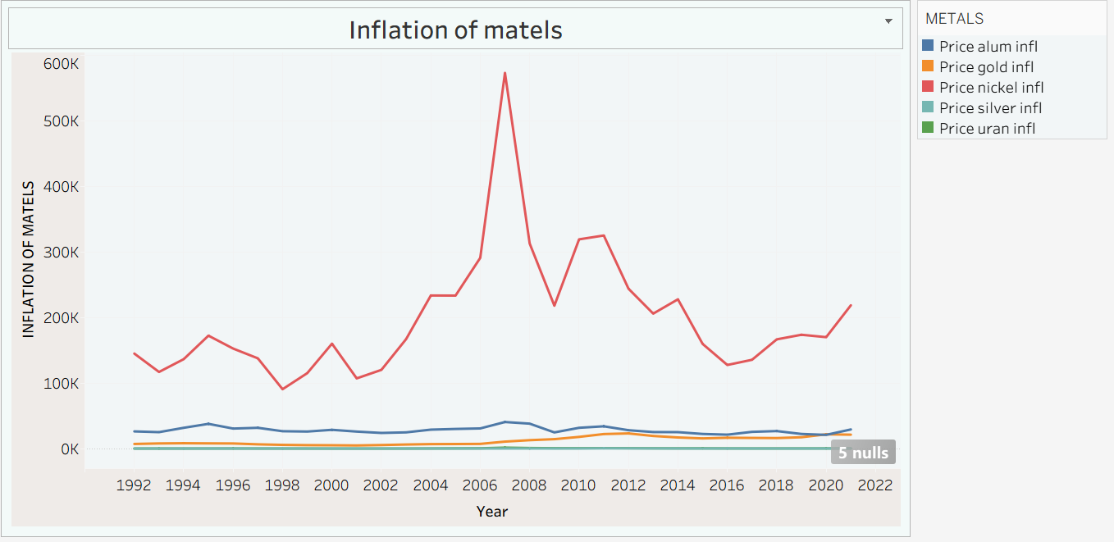
"We can see that there is very high inflation in the price of nickel."

Slide 8
Correlation
corrlation of gold price and gold inflation: 0.9861226023352059
corrlation of silver price and silver inflation: 0.9862195885781909
corrlation of alum price and alum inflation: 0.6238469341482332
corrlation of nical price and nical inflation: 0.9626151124154905
corrlation of uran price and uran inflation: 0.9844185136619086

Slide 9
.
corrlation of gold price and inflation rate: -0.8608740496321354
corrlation of silver price and inflation rate: -0.7662151924962707
corrlation of alum price and inflation rate: -0.591238321846525
corrlation of nical price and inflation rate: -0.536963289752732
corrlation of uran price and inflation rate: -0.5354782051350482
metals have negative correlation with general inflation
but positive correlation with their own inflation
makes sense:
general inflation might hurt industrial demand (negative corr)
own inflation reflects metal-specific trends(positve corr)

Slide 10
Coefficient of variation(CV)
The Coefficient of Variation (CV) is a statistical measure of relative variability. It shows how large the standard deviation is compared to the mean of a dataset.
📌 Formula
CV=Standard Deviation/Mean
→ Lower CV means lower risk relative to return.
❗ High variability (less consistency)
The data values are widely spread out compared to the mean.
In simple words:
High CV → More variation, more instability
Low CV → Less variation, more stability

Slide 11
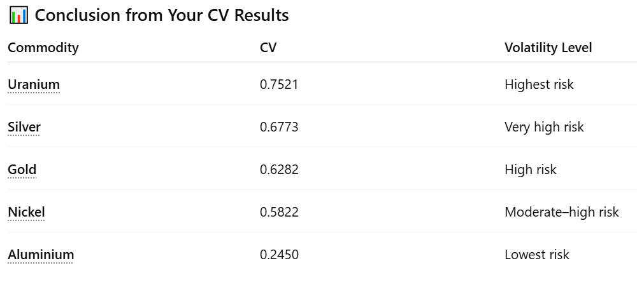
.

Slide 12
📌 Conclusion
Precious metals like gold and silver move closely together.
Nickel has the highest sales level and significant sales .
Uranium is the most volatile metal.
Aluminium is the most stable.
Metal prices do not always move in line with general inflation.
Risk levels differ significantly across metals.

Slide 13
Thank you

